Slide 1
Presentation of Final Year Project:
VISION BASED CRUISE CONTROL FOR AUTONOMOUS VEHICLES
AASHIKA CHAKRAVARTY (Matriculation: 431325)
Domain : Digital Image processing
HOCHSCHULE WISMAR UNIVERSITY OF APPLIED SCIENCES: TECHNOLOGY, BUSINESS, AND DESIGN
MASTER IN INFORMATION AND ELECTRICAL ENGINEERING
DEPARTMENT OF ELECTRICAL ENGINEERING AND COMPUTER SCIENCE
1

Slide 2
CONTENTS
Introduction
System architecture
Lane Detection
Timing Analysis
Object Detection
Algorithm Comparison
Object detection using YOLO
Result Analysis
Imitation Learning on Unity
Conclusion
Future scope
References

Slide 3
INTRODUCTION
This is the final year project I have worked on during my Bachelor’s Degree at PES Institute of Technology in Bangalore, India.
Autonomous vehicles have brought about one of the largest societal revolutions. With numerous benefits and solutions to current daily issues, they’re on the road to become a staple in the automotive industry soon.
Our goal was to contribute to this field, emulating advancements made by companies like Tesla, and build a miniature car that can safely navigate and drive itself, staying within the lane, and watching out for pedestrians and traffic signals.
2

Slide 4
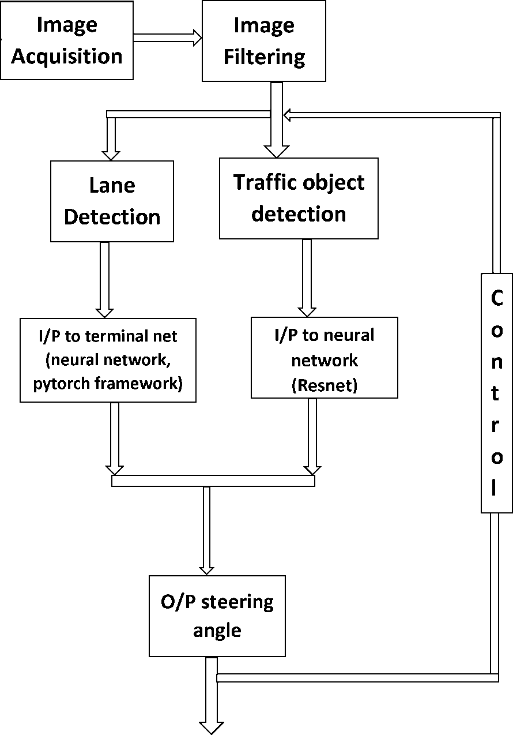
SYSTEM ARCHITECTURE
Input
IMAGE ACQUISITION:
Image acquisition is an action of retrieving an image from an external source for further processing.
IMAGE FILTERING:
Filtering is a technique for modifying or enhancing an image. This then leads to Lane and Object Detection.
OUTPUT STEERING ANGLE:
It is done based on calculating the slope of the centred virtual line achieved by Hough Transform.
Output

Slide 5
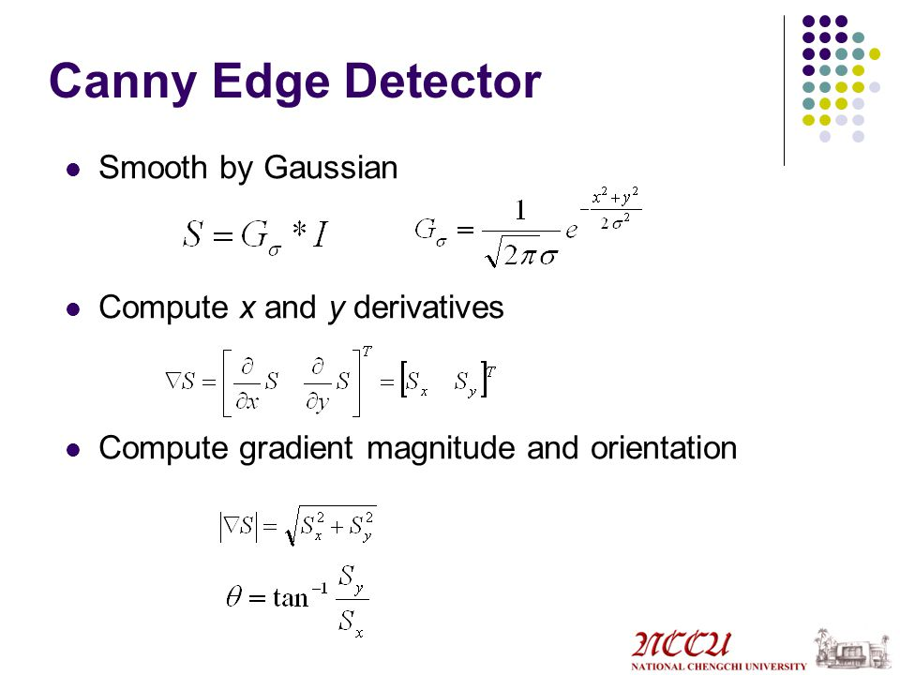
LANE DETECTION
Image Acquisition
Gaussian Blur
Canny Edge Detection
Noise Reduction
Intensity Gradient
Non-Maxima Suppression
Hysteresis Thresholding
Region of Interest
Hough Lines P
Average Slope Intercept
Calculating the Central Virtual Line

Slide 6
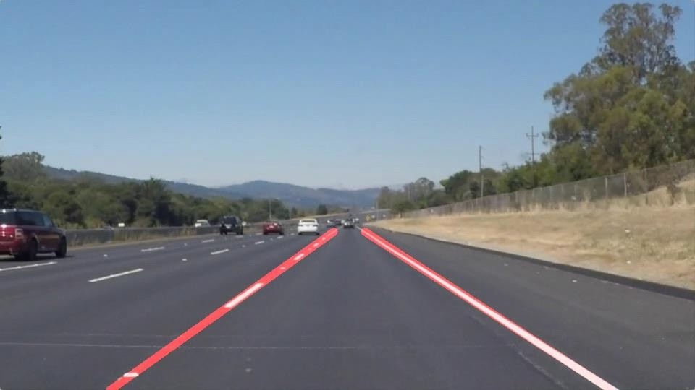
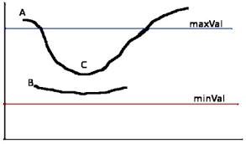
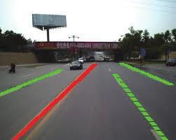
All the lines in an image are detected and converted into coordinates, through which slope can be calculated.
Hough Line P
Any pixel values above the maxVal are preserved and the values below minVal are discarded.
Hysteresis Thresholding
Using the detected side lines of the road, the centered virtual line is calculated.
Central Virtual Line Calculation

Slide 7
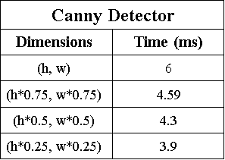
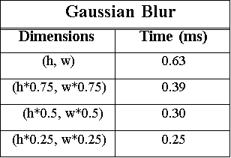
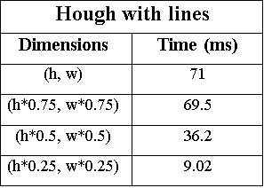
TIMING ANALYSIS
With no reduction in dimensions, time taken is 0.3547 s
With 0.25 reduction in dimensions of image, time taken is 0.35020 s
With 0.5 reduction in dimensions of image time taken is 0.3513 s
With 0.75 reduction in dimensions of image time taken is 0.3522 s

Slide 8
OBJECT DETECTION
Analysis of various object detection algorithms.
Region with Convolutional Neural Network (R-CNN)
Fast R-CNN
Single Shot multibox Detector (SSD)
You Only Look Once (YOLO)

Slide 9
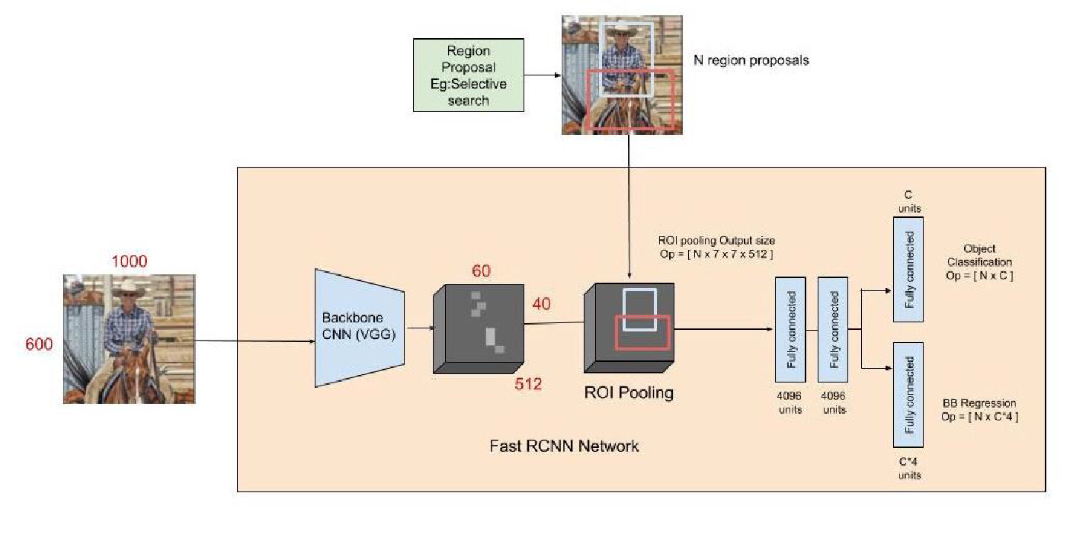
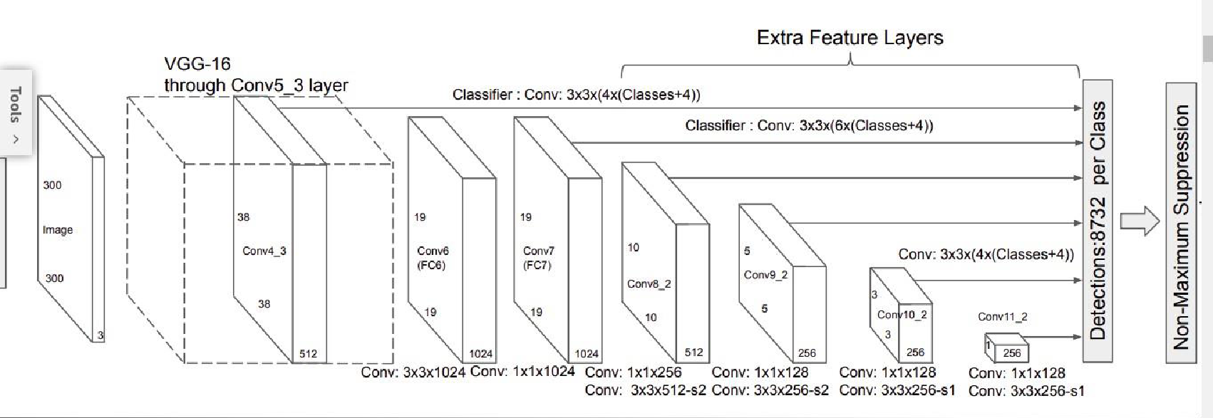
Fast R-CNN
structure
SSD
structure

Slide 10
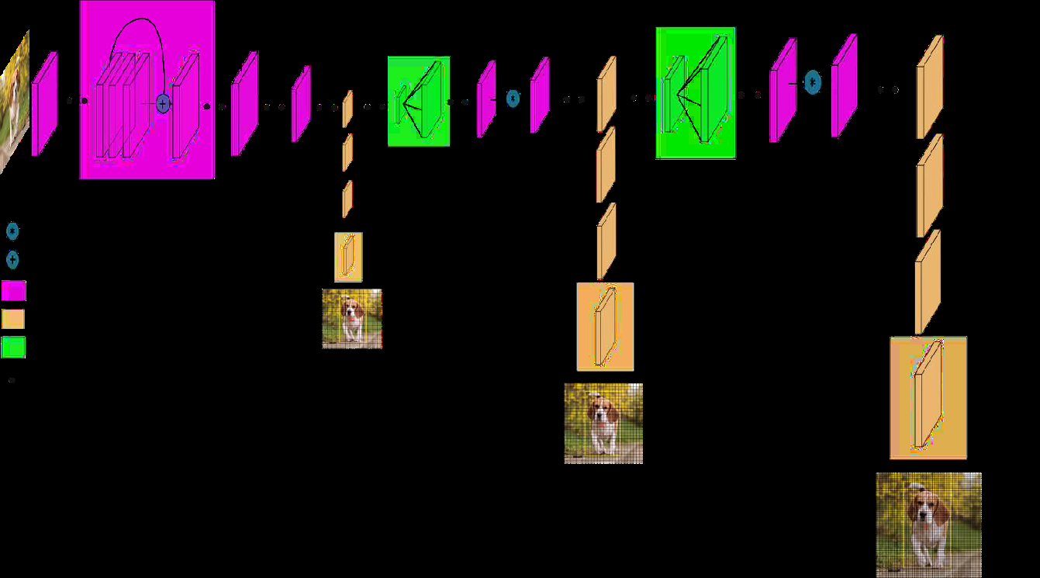
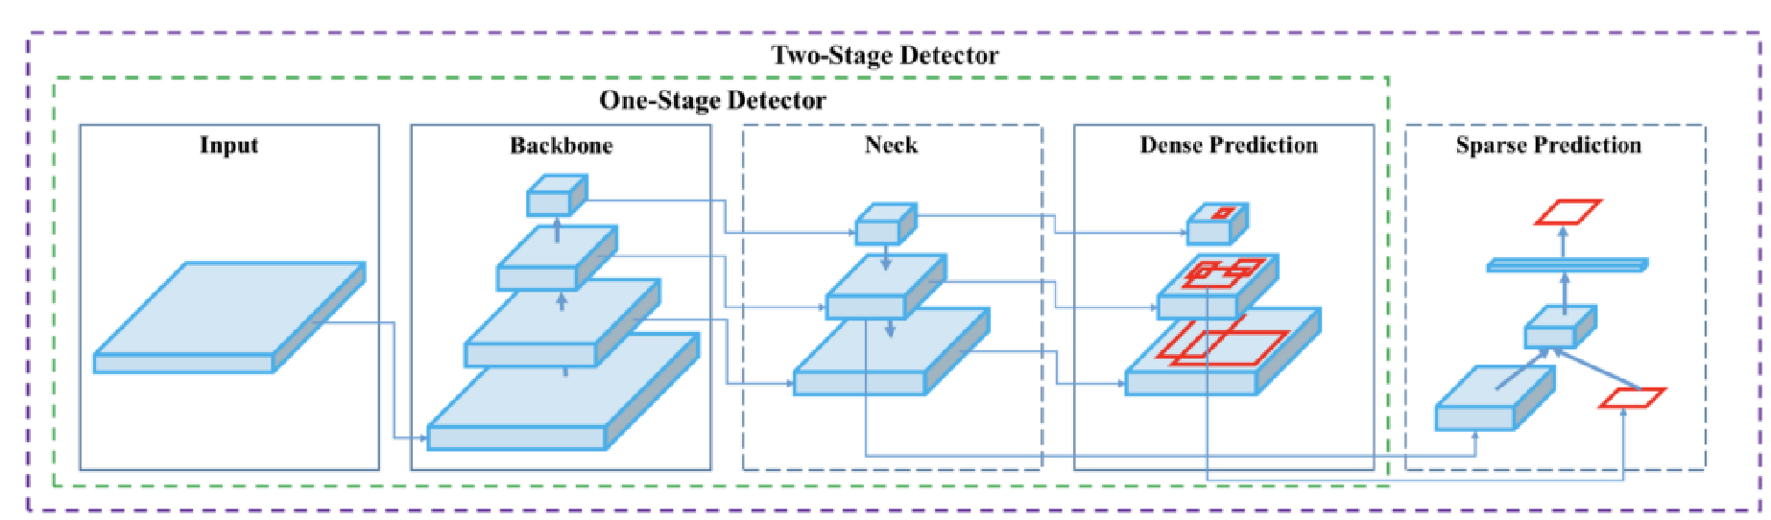
YOLO-V3 Architecture: Inspired by ResNet and FPN (Feature-Pyramid Network) architectures, YOLO-V3 feature extractor, called Darknet-53 (it has 52 convolutions) contains skip connections (like ResNet) and 3 prediction heads (like FPN) — each processing the image at a different spatial compression.
YOLO v3 Network Architecture
YoloV4 is an important improvement of YoloV3, the implementation of a new architecture in the Backbone and the modifications in the Neck have improved the mAP (mean Average Precision) by 10% and the number of FPS (Frames per Second) by 12%. In addition, it has become easier to train this neural network on a single GPU.
YOLO v4 Network Architecture

Slide 11
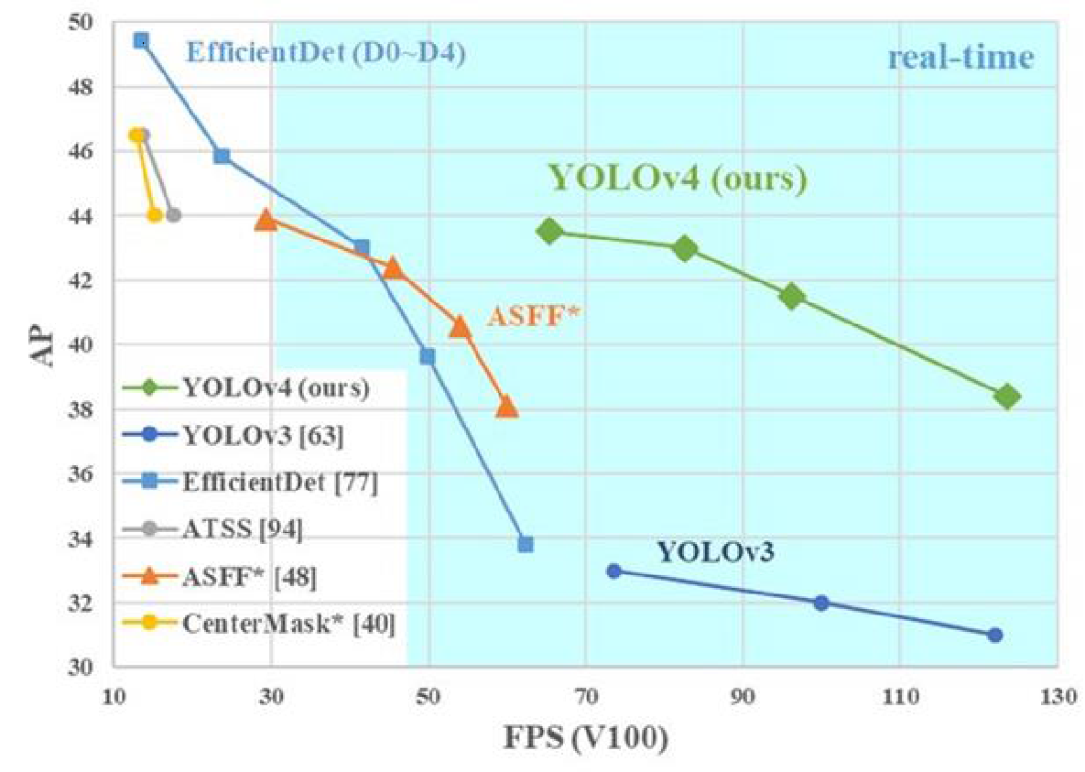
ALGORITHM COMPARISON
The speed and accuracy has been improved as the model has been worked on and developed further.
Fast R-CNN was faster than R-CNN.
Single Shot Detector was better than them both.
It was found that by using the YOLO V.3 model multiple objects can be detected faster.
YOLO V.4 has proven to be faster and much more accurate, with a higher frame rate, which aids in real time detection.

Slide 12
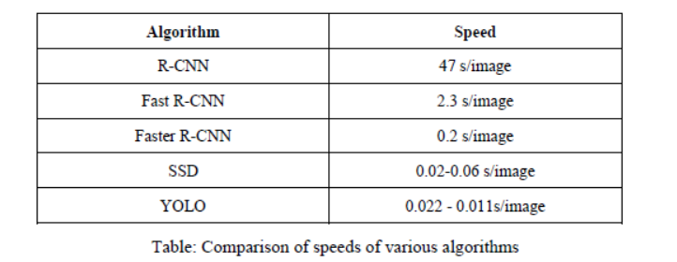
ALGORITHM COMPARISON

Slide 13
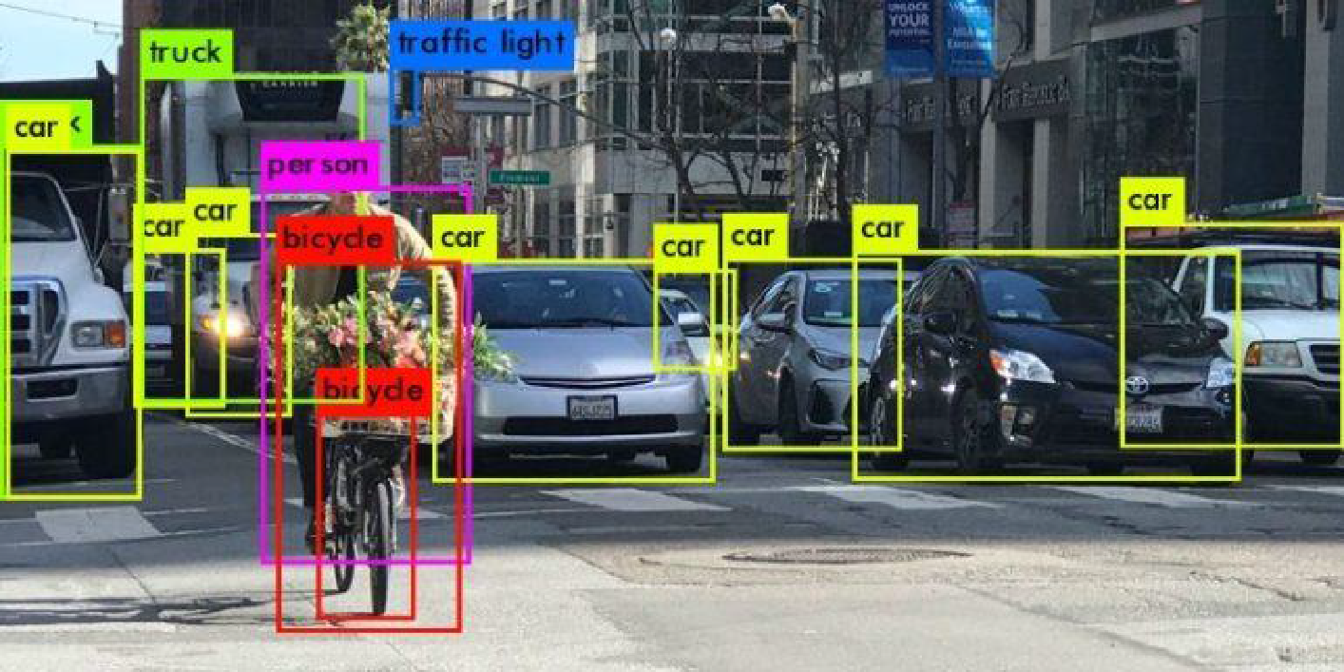
OBJECT DETECTION USING YOLO
Process the image and perform the ‘GetClasses’ function.
Detecting the Object and drawing boxes.
Count of Objects.
Object detection and Classification

Slide 14
RESULT ANALYSIS
Automation can help reduce the number of crashes on our roads.
Higher levels of autonomy have the potential to reduce risky and dangerous driver behaviors.
Real time traffic lane detection has been implemented using deep learning.
By using the YOLO model as well as the Resnet model together, we were able to obtain a higher accuracy but with a larger delay.
We use YOLO V.4 as the object detection algorithm for our project, which is fast as well as gives us a higher accuracy.

Slide 15
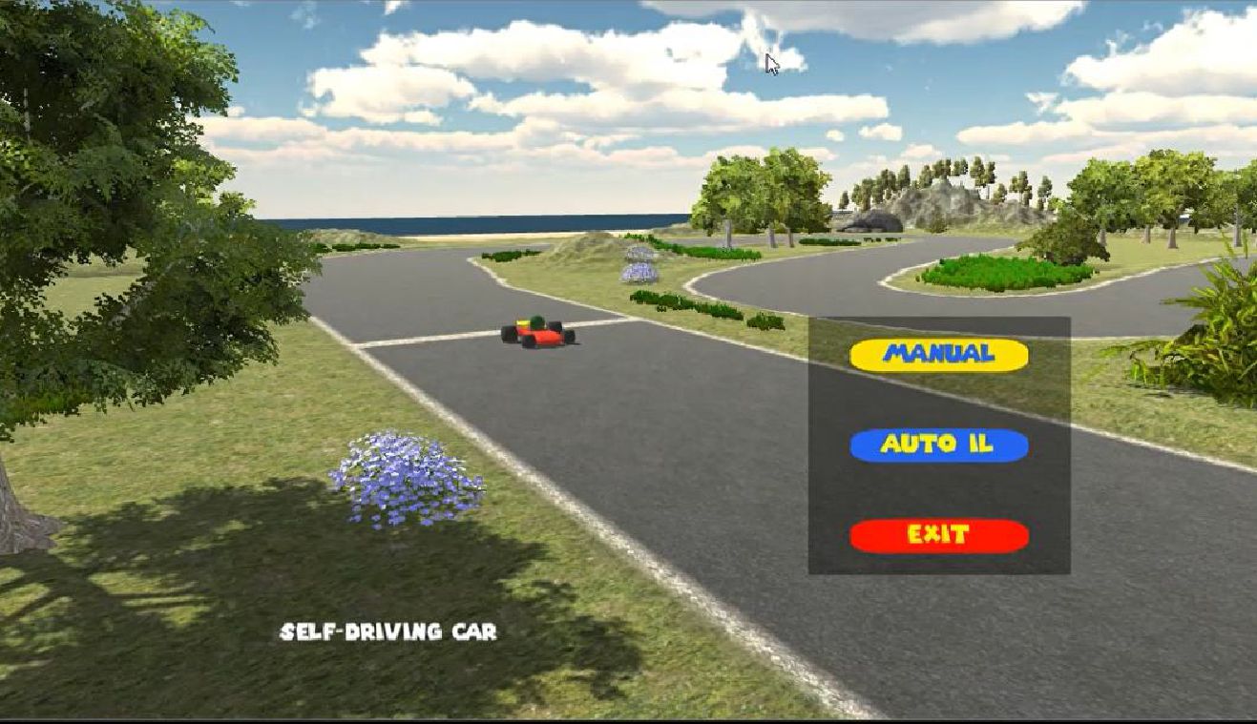
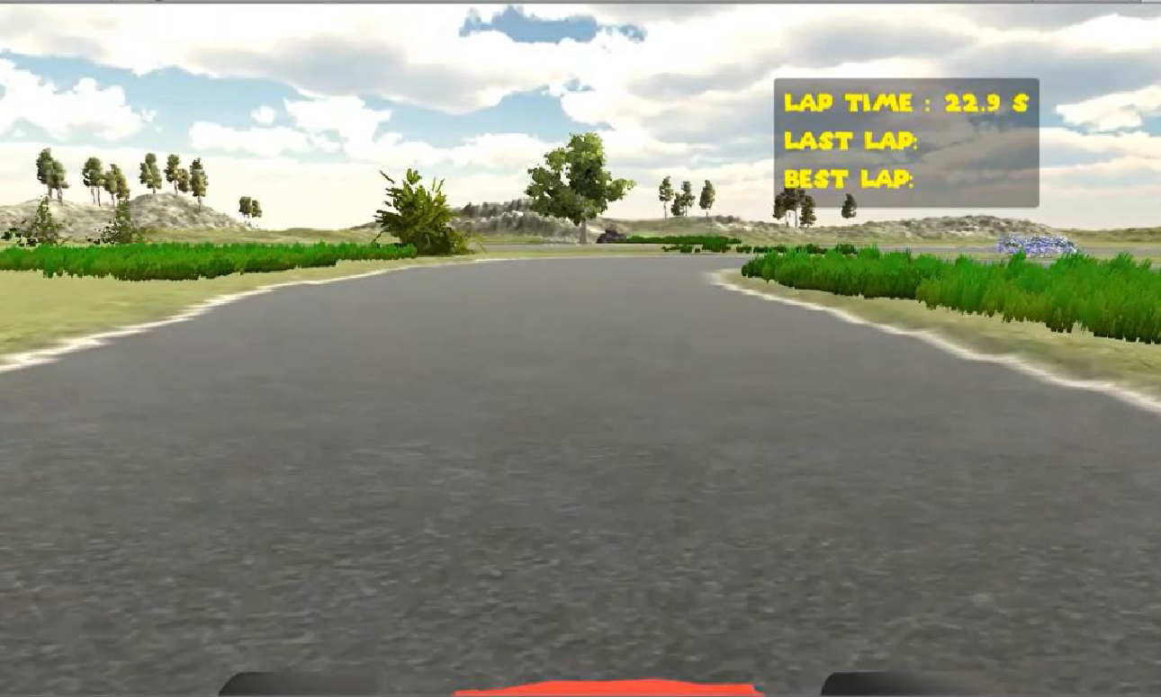
IMITATION LEARNING ON UNITY
Output to be generated is known, given a specific input. Data experience is collected, from which we derive examples of input-output relation. Network will be trained on this dataset. This is called supervised learning.
We will be providing examples of input observations and output actions. Here, the car is the student, and we will train its neural network to learn from the examples we provide. This is known as behavioral cloning.
Manual and Autonomous modes on Unity engine model
Front view of the track we have built

Slide 16
In the CarAgent Script, we need to link the brain that’s controlling the car is the Teacher brain during training). We also need to link the camera as an input to the NN (which is the front camera of the car).
Unity ML toolkit comes with many predefined configurations; we need to set the name for the brain to be followed, which is the Teacher brain, and the learning brain is set as the Student brain.
We now need to drive the car around the track for a few laps, and let the student learn our driving techniques. The Student brain will only be as good as the Teacher brain’s training.
We are using the Student brain network for prediction, not for learning. Student brain type is set to ‘internal’, which means it reads observations, and automatically generates actions.

Slide 17
CONCLUSION
We have been able to implement a lane identification and steering output mechanism which gives us the steering angles to maintain a car right in between the lanes.
The object detection algorithm YOLOv4 has been able to run smoothly to identify multiple objects and identify their coordinates from the video feed.
The behavioral cloning model in unity has been tested, but its performance has to be evaluated in scenarios with obstacles and random objects, not just under clinical conditions

Slide 18
FUTURE SCOPE
The future steps in this endeavor will be to implement this model in a simulated environment and test the model in multiple challenging circumstances, different environments
The interaction between the python code which is already implemented and the Unity software has been a challenge we are trying to overcome. The socket.io software package is a possible solution which is being implemented.
Ability to be able to maneuver around obstacles which can be achieved by using behavioral modeling

Slide 19
REFERENCES
Real-Time Lane Detection and Tracking for Advanced Driver Assistance Systems. Hazrat Bilal1, Baoqun Yin1, Jawad Khan2, Luyang Wang1, Jing Zhang1, and Aakash Kumar Proceedings of the 38th Chinese Control Conference, July 27-30, 2019, Guangzhou, China.
Lane Detection and Tracking, For Intelligent Vehicles: A Survey Mehdi FENICHE National School of Applied Sciences Kenitra- Moroccomehdifeniche@gmail.com, Tomader MAZRINational School of Applied Sciences, Kenitra-Morocco, IEEE/ICCSRE2019, 22-24 July, 2019, Agadir, Morocco.
Lane_detect2Curve Path Prediction and Vehicle Detection, in Lane Roads Using Deep Learning for, Autonomous Vehicles G. Pavithra, N.M. Dhanya February 2019
Object Detection for Autonomous Vehicles Gene Lewis, Stanford University, Stanford, CA, glewis17@cs.stanford.edu
YOLOv3: An Incremental Improvement; by Joseph Redmon, Ali Farhadi, University of Washington, 2018 [https://arxiv.org/abs/1804.02767]
Deep Residual Learning for Image Recognition; by Kaiming He, Xiangyu Zhang, Shaoqing Ren, Jian Sun, Microsoft Research [https://arxiv.org/pdf/1512.03385v1.pdf]

Slide 20
THANK YOU
email: a.chakravarty@stud.hs-wismar.de
contact: +49 176 86918806

